Slide 1


VISVESVARAYA TECHNOLOGICAL UNIVERSITY
JYOTHY INSTITUTE OF TECHNOLOGY
Department of Information Science and Engineering
A project presentation on
“Application of Machine Learning for Tongue Diagnosis in Ayurveda”
Submitted by
Arundhati Hegde -1JT16IS006
Shivani S Pai -1JT16IS046
Sumanth N S -1JT16IS055
Under the guidance of
Dr. Harshvardhan Tiwari
Associate Professor and Head
Dept. of Information Science & Engineering

Slide 2
CONTENTS
Abstract
Introduction
Review of Literature
Methodology
Results
Testing
Applications
Conclusion
References
Appendix

Slide 3
ABSTRACT
The aim of the study is to apply digital image processing and Machine learning techniques for Ayurveda to evaluate the patient’s health status.
The objective of our proposed work is to classify the tongue image into vata, pitta, kapha (tri-dosha) with the colour, coating, texture and shape features. These characteristics largely also would be determined by the portion of the tongue part.

Slide 4
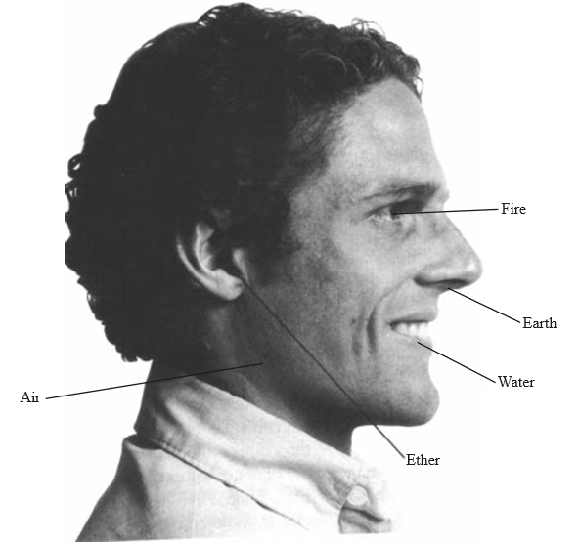
INTRODUCTION

Slide 5
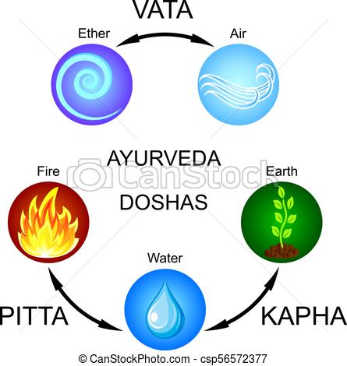
INTRODUCTION
INTRODUCTION
There are three basic principles in human body, they are Tridosha’s :
Vata-Dosha
Pitta-Dosha
Kapha-Dosha

Slide 6
INTRODUCTION
Ayurvedic philosophy maintains that people are born with a specific constitution, which is called the prakruti.
The term diagnosis generally refers to identification of the disease after it has manifested.
Tongue Diagnosis is one of the critical substances of "Four Diagnoses" in Ayurveda Medicine.
Conventional tongue analysis rely upon perceptions of tongue highlights, for example shading, shape, dampness, and surface by AYURVEDA specialists.
The after-effects of tongue images are analyzed are affected by the experience of AYURVEDA specialists as well as by the encompassing conditions.

Slide 7
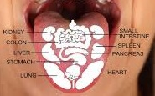
INTRODUCTION
A discolouration and sensitivity of a particular area of the tongue indicates a disorder in the organ corresponding to the area .
A whitish tongue indicates Kapha derangement and mucus accumulation.
A red or yellow-green tongue indicates Pitta derangement.
A black to brown colouration indicates Vata derangement.
A dehydrated tongue is symptomatic of a decrease in the dhatu Rasa (plasma), while a pale tongue indicates a decrease in the dhatu Rakta (red blood cells).

Slide 8
LITERATURE REVIEW
Reference Number | Title | Findings | Shortcomings
[1] | Ayurveda: The Science of self-healing | Overview of tri-dosha | No algorithmic approach
[2] | Regional Image Analysis of the Tongue colour Spectrum | Spectral analysis of the tongue features | Spectral values can be improved with better techniques
[3] | Significant Geometry Features in Tongue Image Analysis | Analysis of tongue based on the shape | Inclusion of various shapes leading to more error in accuracy due to less number of test examples of a particular shape.
[4] | Tongue image segmentation based on snake model and radial edge detection | Intensity value dependence on the diagnosis method | The intensity variation may hamper the image
[5] | Tongue Images Classification Based on Constrained High Dispersal Network | SVM classification of the colour correlation matrix | Particle Swarm may not give the accurate result
[6] | Reliability studies of diagnostic methods in Indian traditional Ayurveda medicine: An overview | Indian method of tongue diagnosis overview | No approach to model building and classification

Slide 9
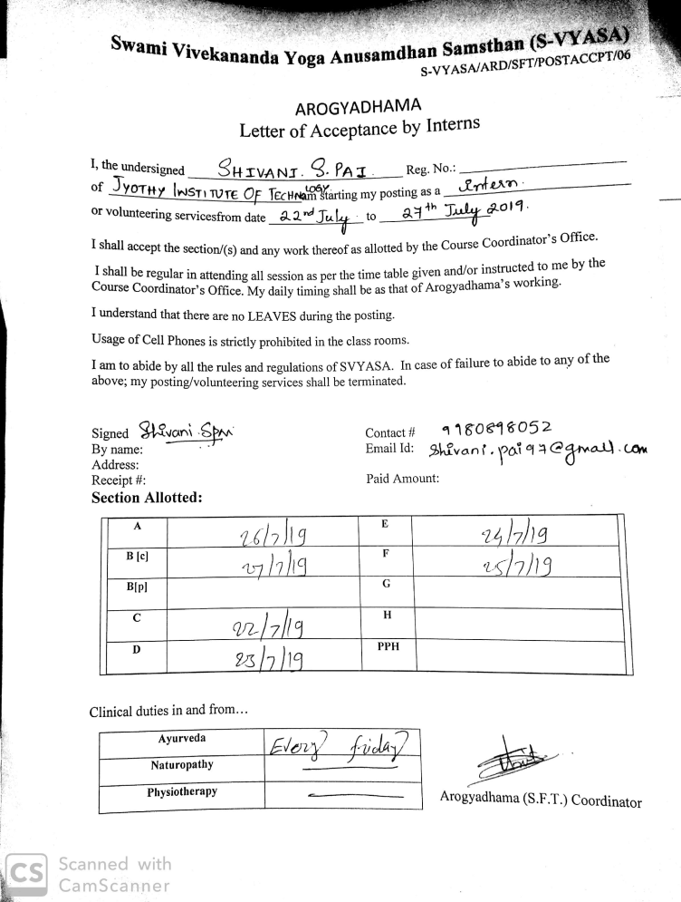
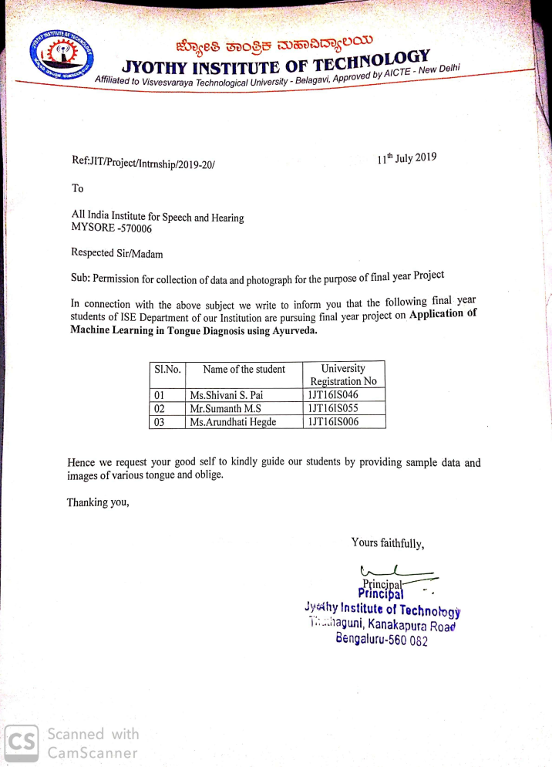
a. Svyasa University
b. All India Institute

Slide 10
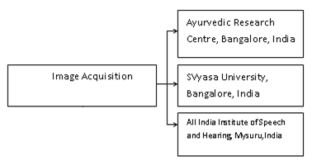
METHODOLOGY
1. Image Acquisition

Slide 11
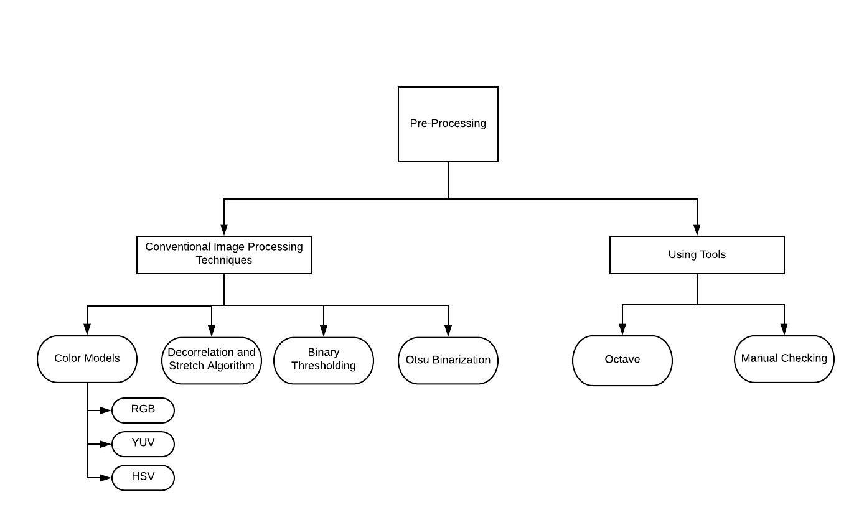
METHODOLOGY
2. Pre-processing

Slide 12
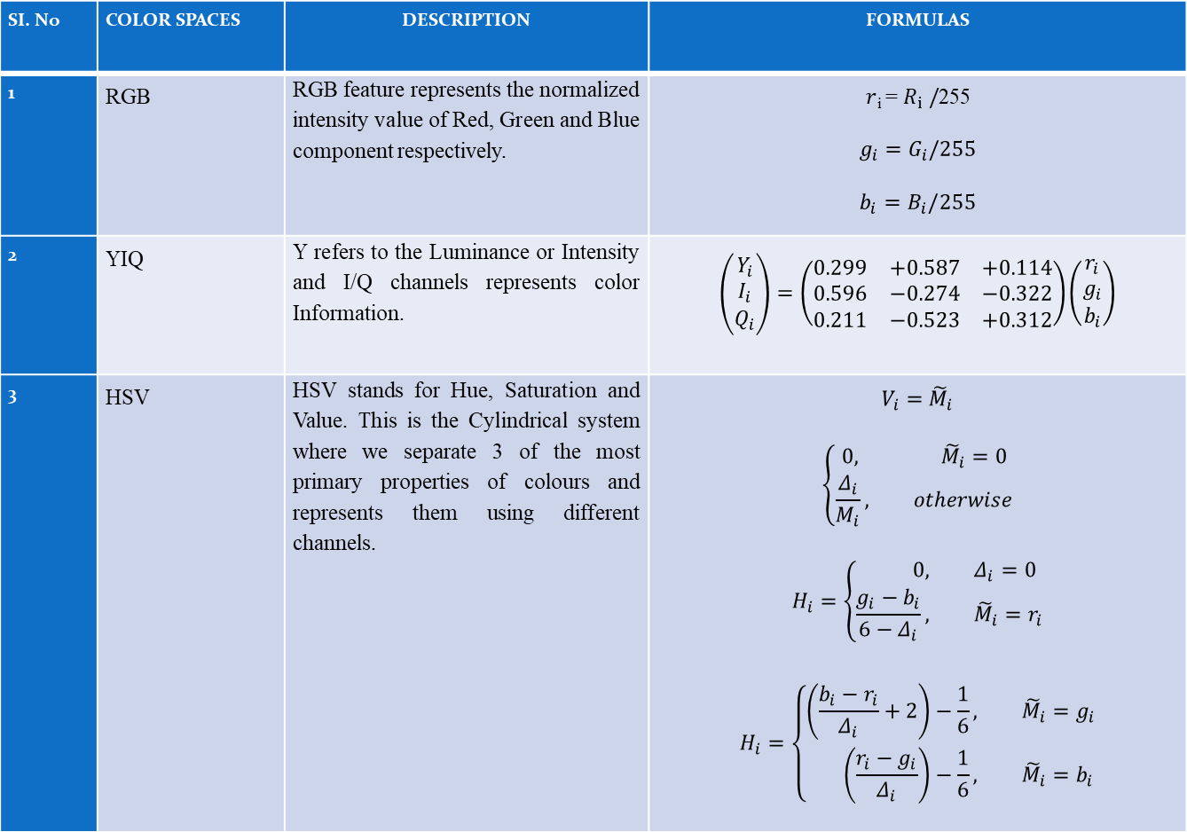
COLOR MODELS
SI. No | COLOR SPACES | DESCRIPTION | FORMULAS
1 | RGB | RGB feature represents the normalized intensity value of Red, Green and Blue component respectively. | $r$_{i} = $R_{i} /$255 $$g_{i}=G_{i}/255$$ $$b_{i}=B_{i}/255$$
2 | YIQ | Y refers to the Luminance or Intensity and I/Q channels represents color Information. | $$\left(\begin{aligned}Y_{i} \\ I_{i} \\ Q_{i}\end{aligned}\right)=\left(\begin{matrix}0.299 & +0.587 & +0.114 \\ 0.596 & −0.274 & −0.322 \\ 0.211 & −0.523 & +0.312\end{matrix}\right)\left(\begin{aligned}r_{i} \\ g_{i} \\ b_{i}\end{aligned}\right)$$
3 | HSV | HSV stands for Hue, Saturation and Value. This is the Cylindrical system where we separate 3 of the most primary properties of colours and represents them using different channels. | $$V_{i}={\tilde{M}}_{i}$$ $$\left\{\begin{aligned}0, {\tilde{M}}_{i}=0 \\ \frac{Δ_{i}}{M_{i}}, &otherwise\end{aligned}\right.$$ $$H_{i}=\left\{\begin{aligned}0, &Δ_{i}=0 \\ \frac{g_{i}−b_{i}}{6−Δ_{i}}, &{\tilde{M}}_{i}=r_{i}\end{aligned}\right.$$ $$H_{i}=\left\{\begin{aligned}\left(\frac{b_{i}−r_{i}}{Δ_{i}}+2\right)−\frac{1}{6}, &{\tilde{M}}_{i}=g_{i} \\ \left(\frac{r_{i}−g_{i}}{Δ_{i}}\right)−\frac{1}{6}, &{\tilde{M}}_{i}=b_{i}\end{aligned}\right.$$

Slide 13
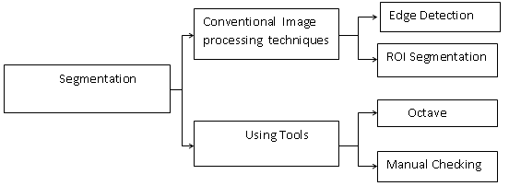
METHODOLOGY
3. Segmentation

Slide 14
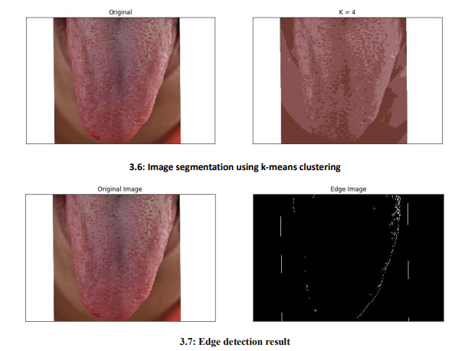
METHODOLOGY
In Edge Detection, we find the boundaries or edges of objects in a tongue image, by determining where the brightness of the image changes dramatically. Edge detection can be used to extract the structure of objects in an .

Slide 15
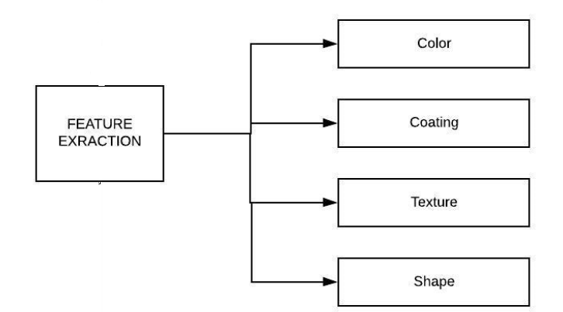
METHODOLOGY
4. Feature Extraction

Slide 16
METHODOLOGY
Local Binary Pattern(LBP)
LBP features in Matlab encode local texture information, which you can use for tasks such as classification, detection, and recognition.
Local Binary Pattern (LBP) is a simple yet very efficient texture operator which labels the pixels of an image by thresholding the neighborhood of each pixel and considers the result as a binary number
Interpolation
Interpolation method used to compute pixel neighbors, which is either 'Linear' or 'Nearest'. Use 'Nearest' for faster computation, but with less accuracy.
Histogram Parameters
The histogram parameters determine how the distribution of binary patterns is aggregated over the image to produce the output features.

Slide 17
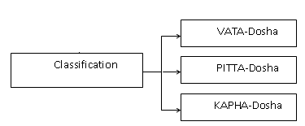
METHODOLOGY
5. Classification

Slide 18
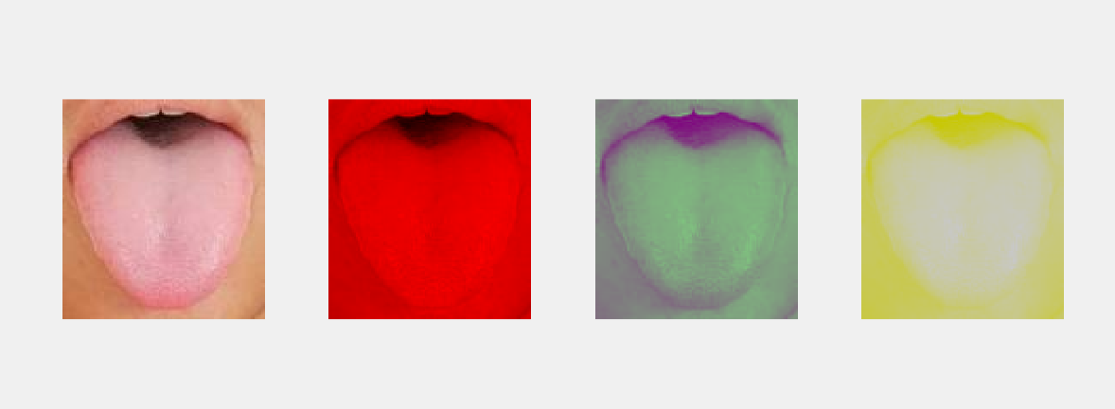
RESULTS
Segmented RGB component of a Tongue image using Least Mean Square error in Matlab.

Slide 19
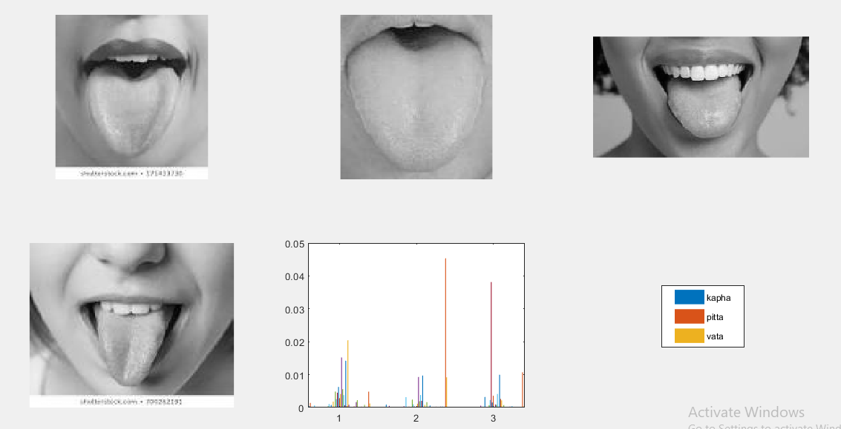
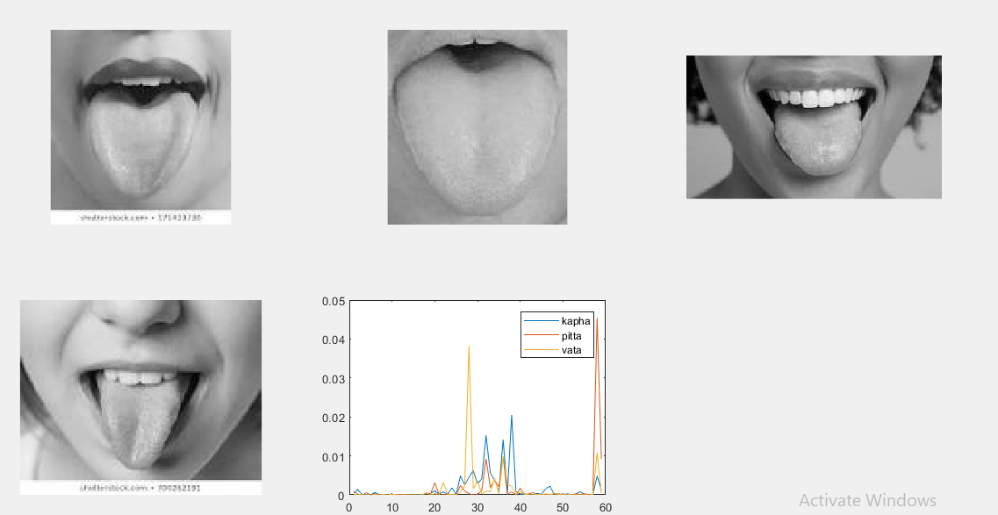
RESULTS
Gauge the similarity between the LBP features by computing the squared error between them.
The squared error is smaller when images have similar texture.

Slide 20
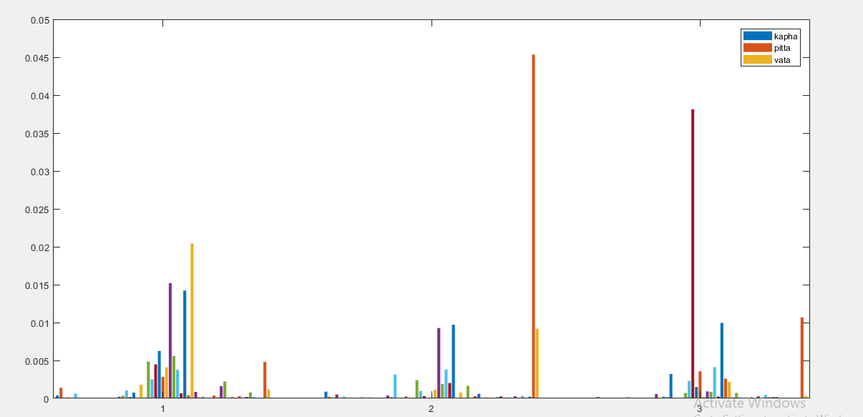
Least Mean Square Error of LBP Histograms

Slide 21
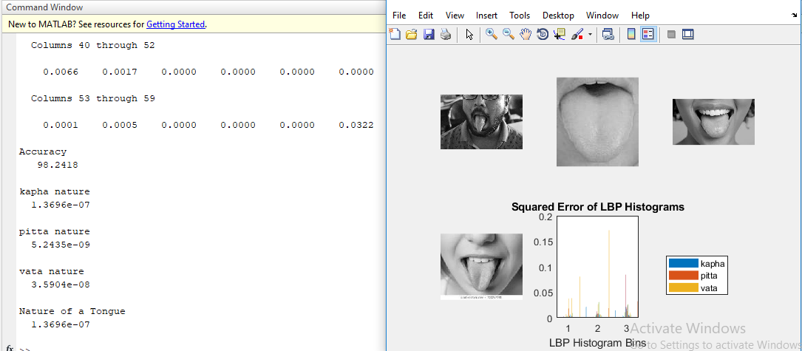
Classification and Accuracy Result

Slide 22
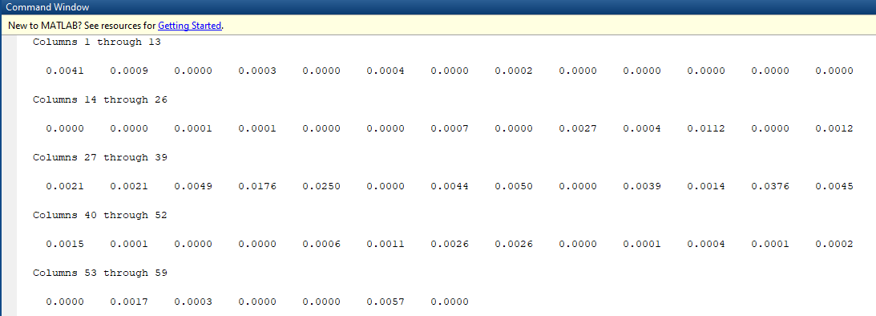
Features after interlacing

Slide 23
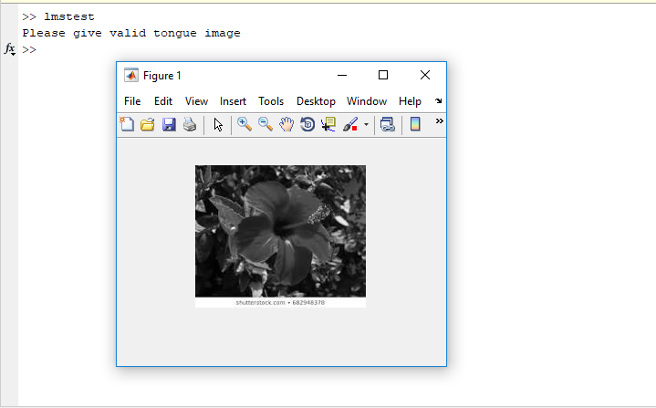
TESTING
Unit Testing

Slide 24
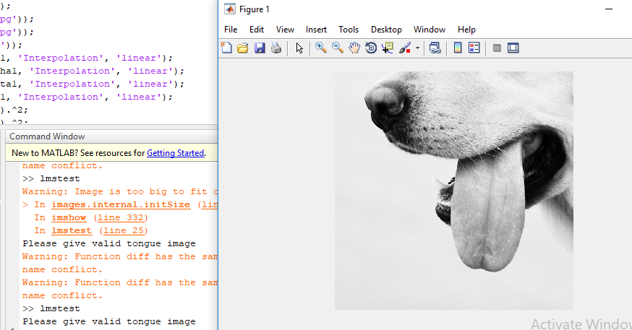
TESTING
White Box Testing

Slide 25
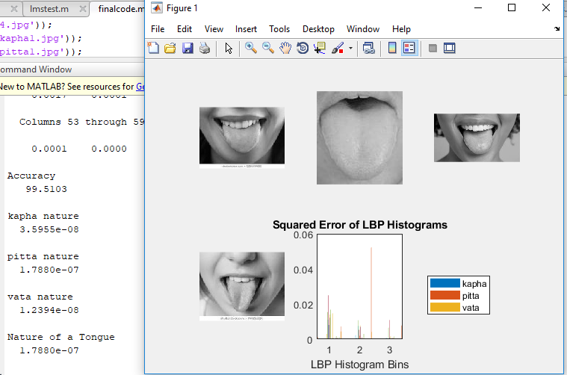
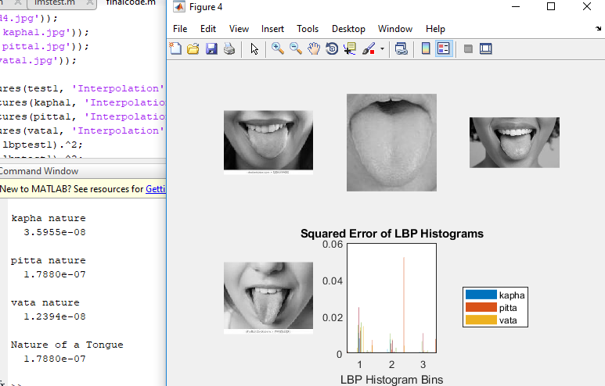
TESTING
Black Box Testing

Slide 26
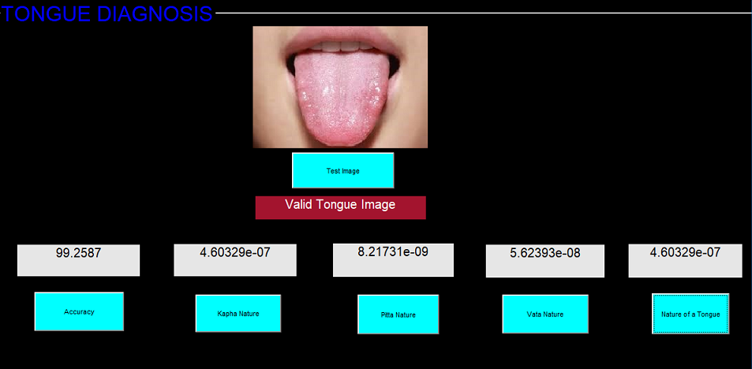
GRAPHICAL USER INTERFACE

Slide 27
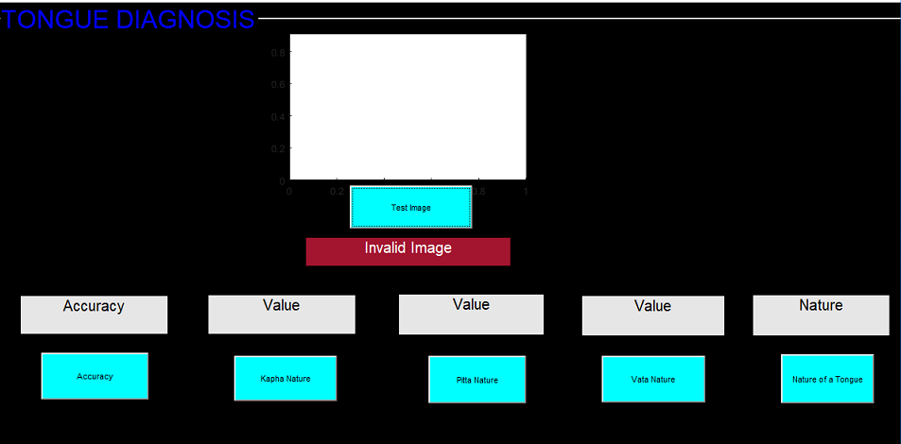
Invalid Image

Slide 28
APPLICATIONS
The objective of the proposed work is to classify the tongue image into vata, pitta, kapha (tri-dosha) with the color, coating, texture and shape features. These characteristics largely also would be determined by the portion of the tongue part (upper region, middle region and sides).
The final outcome of the research is to blend in with the traditional Ayurvedic methods to the machine learning model in a way it describes the most basic class of inspection in medication.

Slide 29
CONCLUSION
At the beginning of the project it was decided that we build a model and classify them into tri-dosha’s using image processing models. Further during the course of the project various tools were necessary and was developed using Matlab.
Least square mean error was used to distinguish the images into respective classes. We have achieved classification into 3 classes of vata, pitta and kapha.
The final outcome of the research is to blend in with the traditional Ayurvedic methods to the machine learning model in a way it describes the most basic class of inspection in medication.

Slide 30
REFERENCES
[1] Dr Vasant Lad” Ayurveda: The science of self-healing”.
[2] Satoshi Yamamoto, Norimichi Tsumura, Toshiya Nakaguchi, Takao Namiki, Yuji Kasahara, Katsutoshi Terasawa, Yoichi Miyake “Regional Image Analysis of the Tongue Colour Spectrum.
[3] BobZhang, HanZhang “Significant Geometry Features in Tongue Image Analysis”, 2015.
[4] Z. C. Fu, X. Q. Li, and F. F. Li, “Tongue image segmentation based on snake model and radial edge detection,” Journal of Image and Graphics, vol. 14, no. 4, pp. 688–693, 2009.
[5] DanMeng, GuitaoCao, YeDuan, MinghuaZhu, LipingTu, DongXu, and JiatuoXu “Tongue Images Classification Based on Constrained High Dispersal Network” Shanghai2012,China
[6] Vrinda Hitendra Kurande, Rasmus Waagepetersen, Egon Toft, Ramjee Prasad “Reliability studies of diagnostic methods in Indian traditional Ayurveda medicine: An overview”, India, 2015

Slide 31
APPENDIX
Participated at ICERTECS19 and won the best paper award in NIT Silchar.
Participated in Ideathon-19 conducted by Atal Incubation Centre and won the first prize, also completed a 6 months internship in the same.
Our work on Tongue Diagnosis is accepted by STM, Taylor and Francis journal.
Compiled our work in Book Chapter and got selected for De Gruyter publications.
Presented a poster at IRISS’20 in IIT-Gandhinagar.

Slide 32
Thank You

